Slide 1
Naïve Bayes with Large Vocabularies
Shannon Quinn
(with thanks to William Cohen and Aarti Singh of CMU)

Slide 2
Naïve Bayes: A primer
Anyone remember how this works?

Slide 3
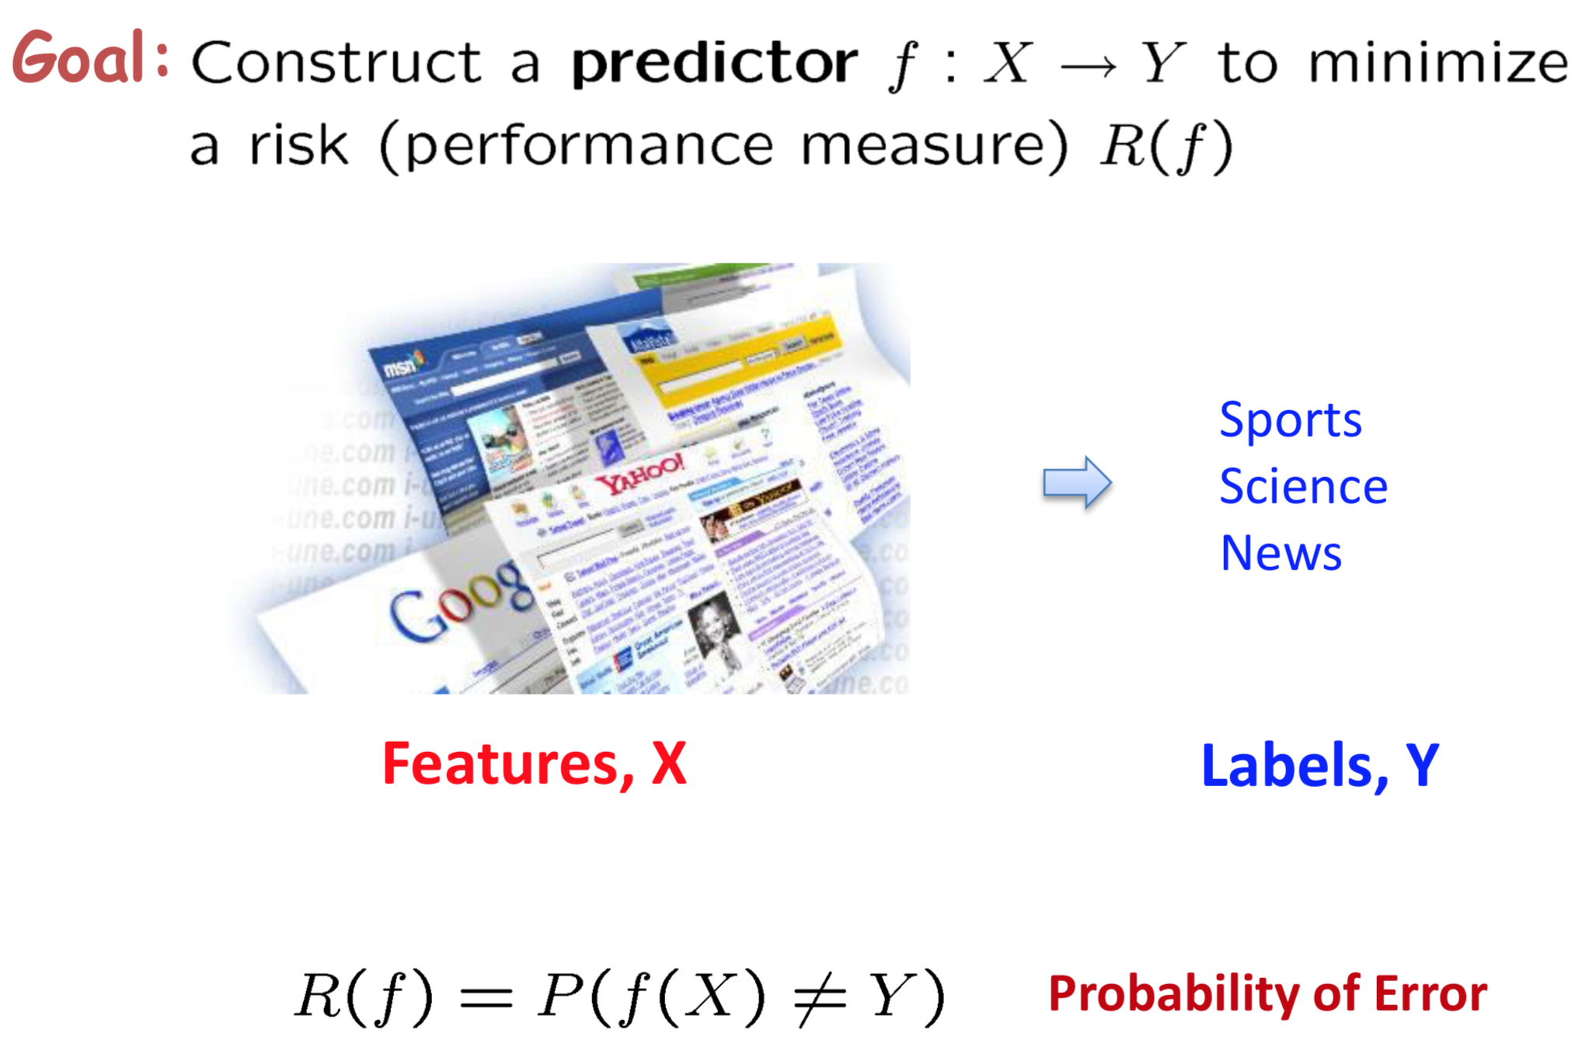
Classification

Slide 4
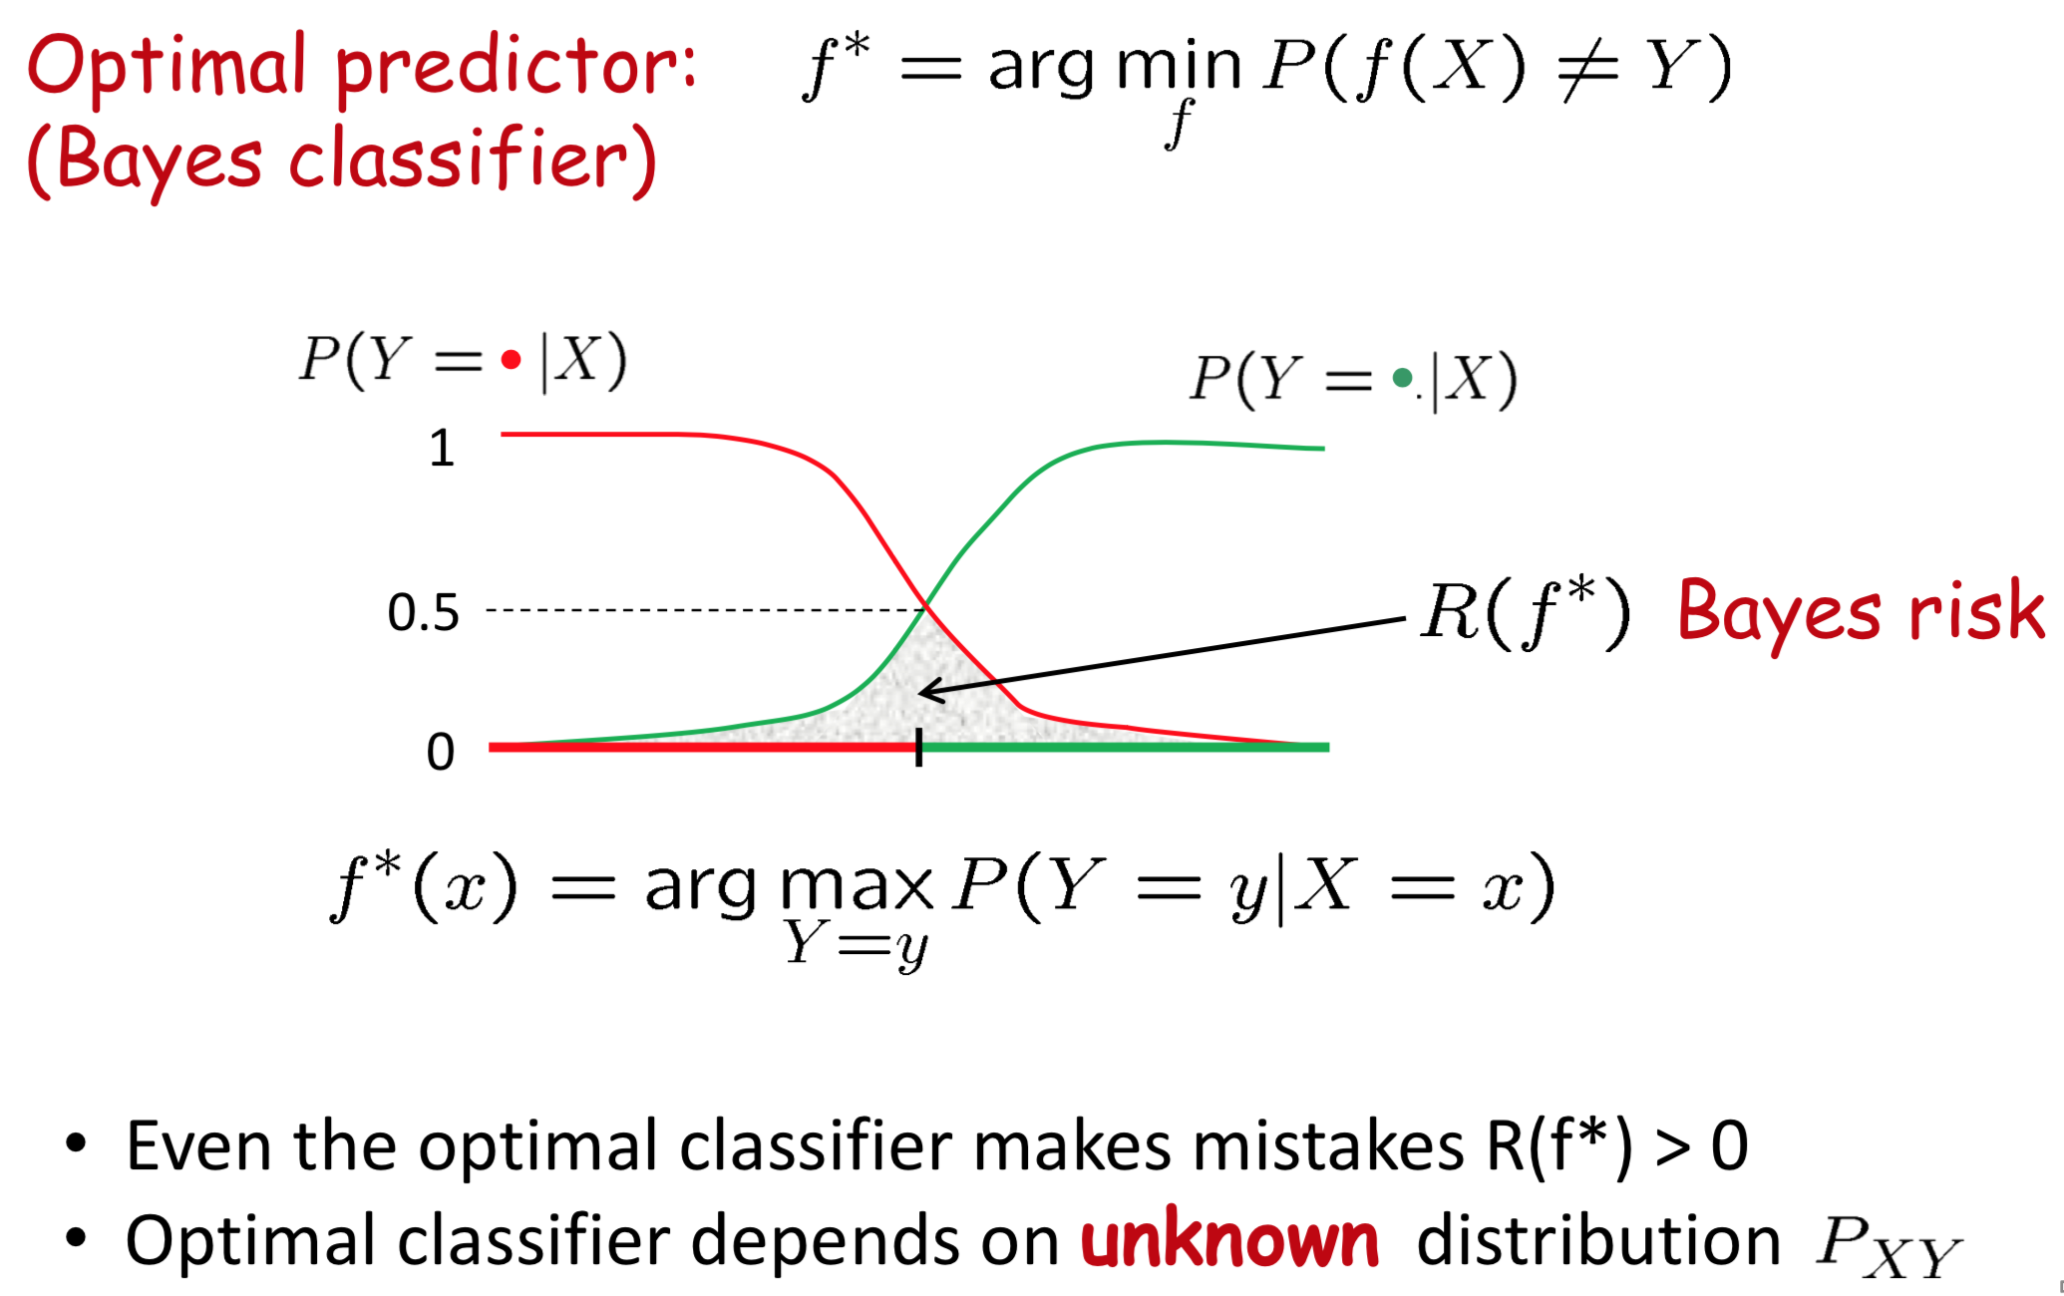
Optimal Classification

Slide 5
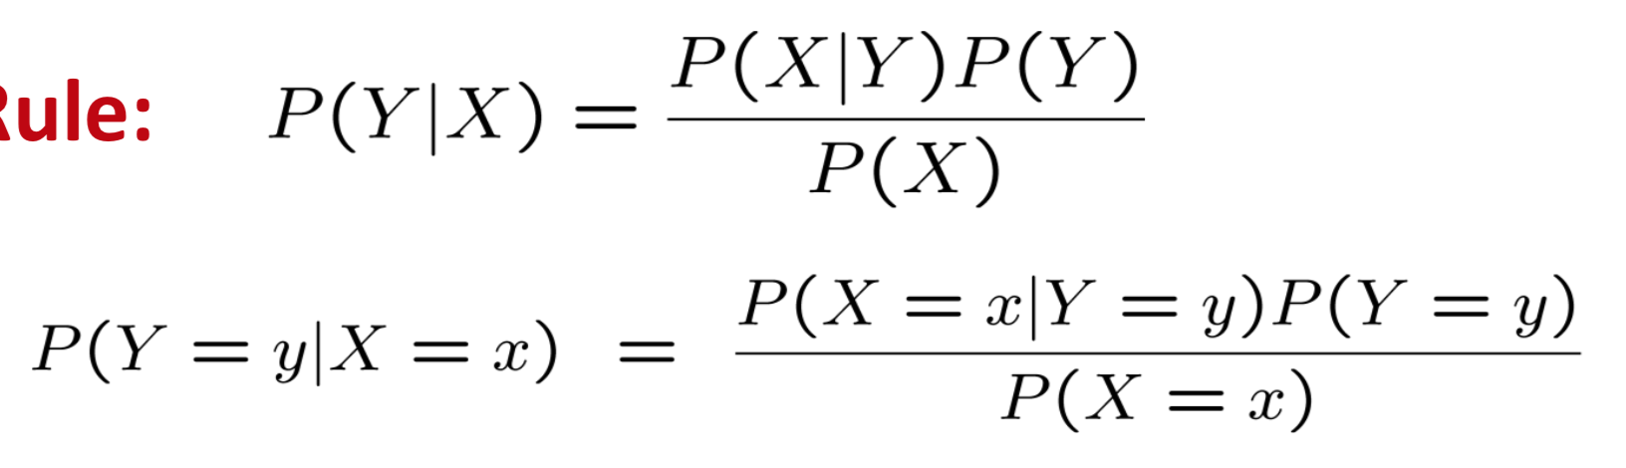
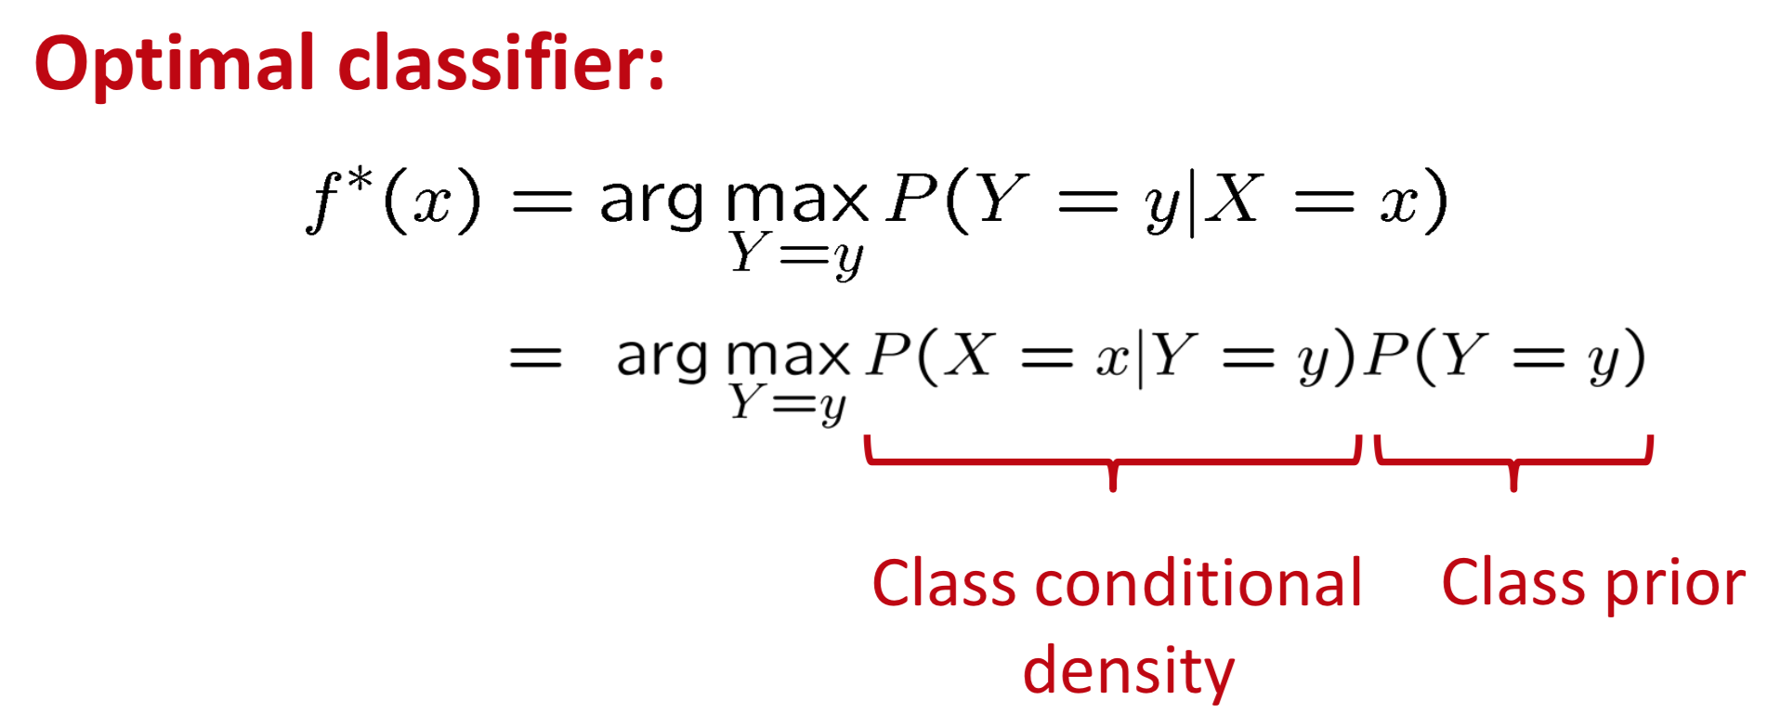
Bayes Rule
Anyone remember?

Slide 6
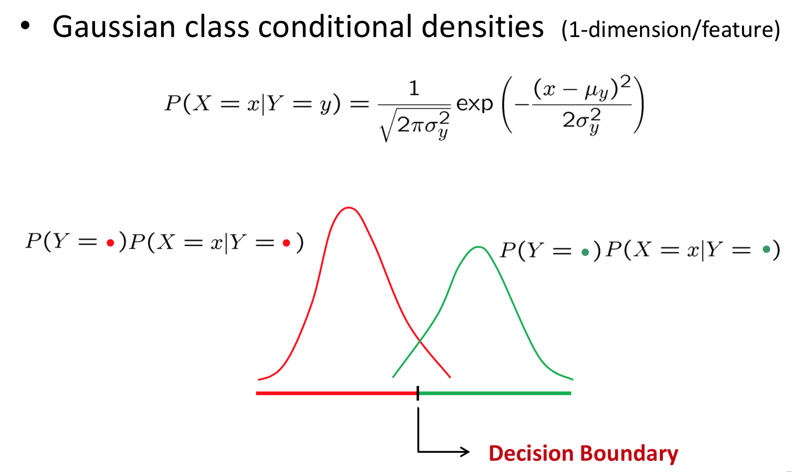
Decision Boundaries

Slide 7
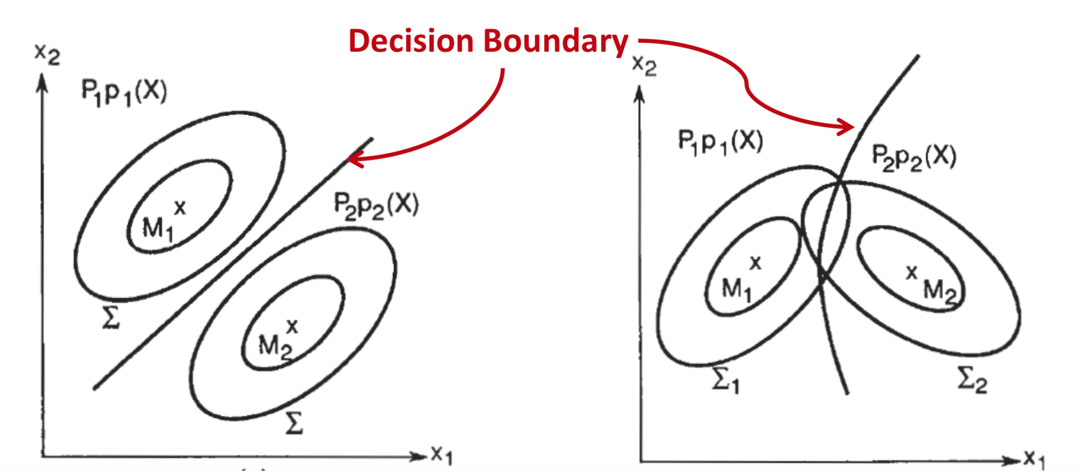

Slide 8
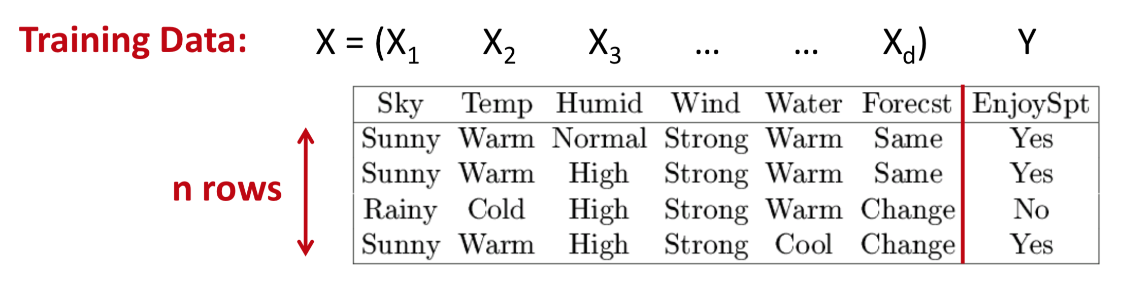


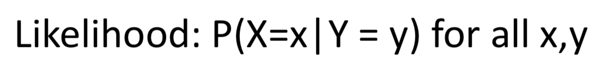
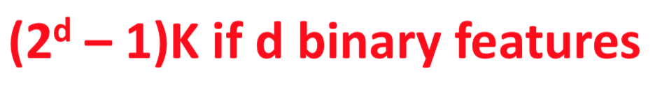
Learning the Optimal Classifier

Slide 9

Curse of dimensionality

Slide 10
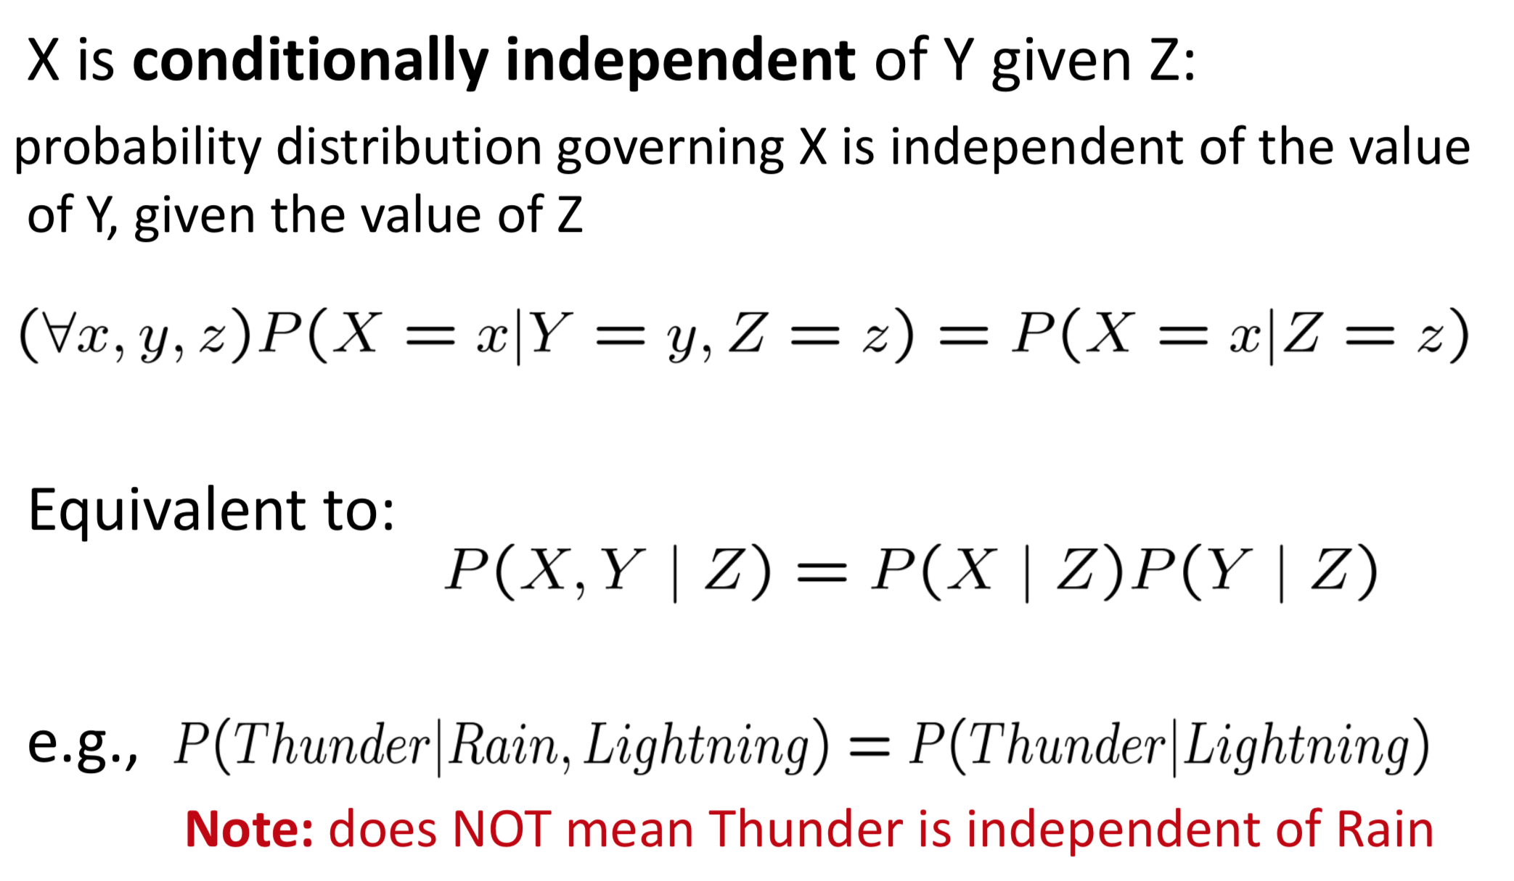
Conditional Independence

Slide 11
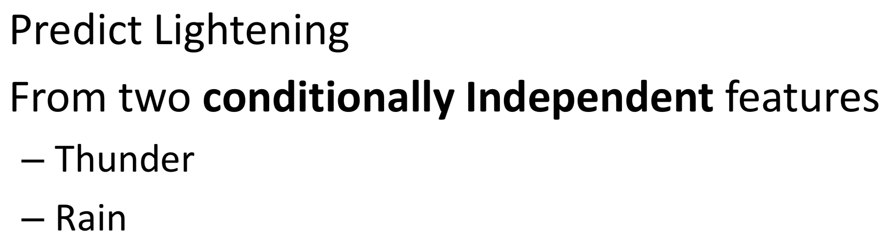
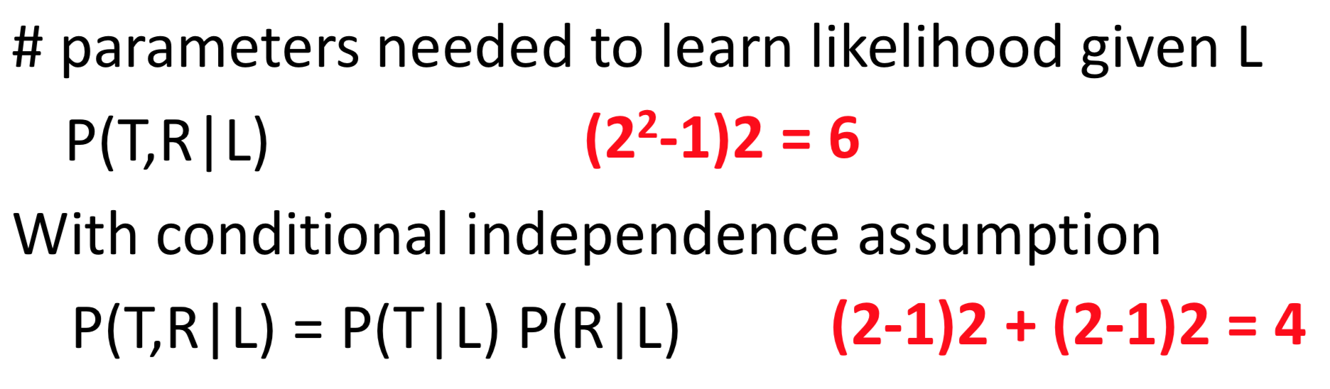
Prediction with Conditional Independence

Slide 12
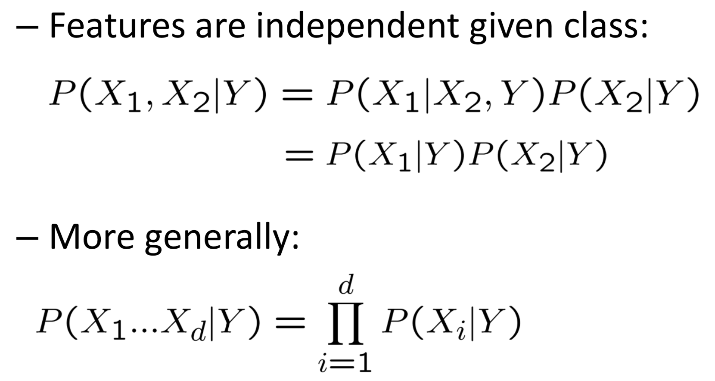
Naïve Bayes Assumption

Slide 13
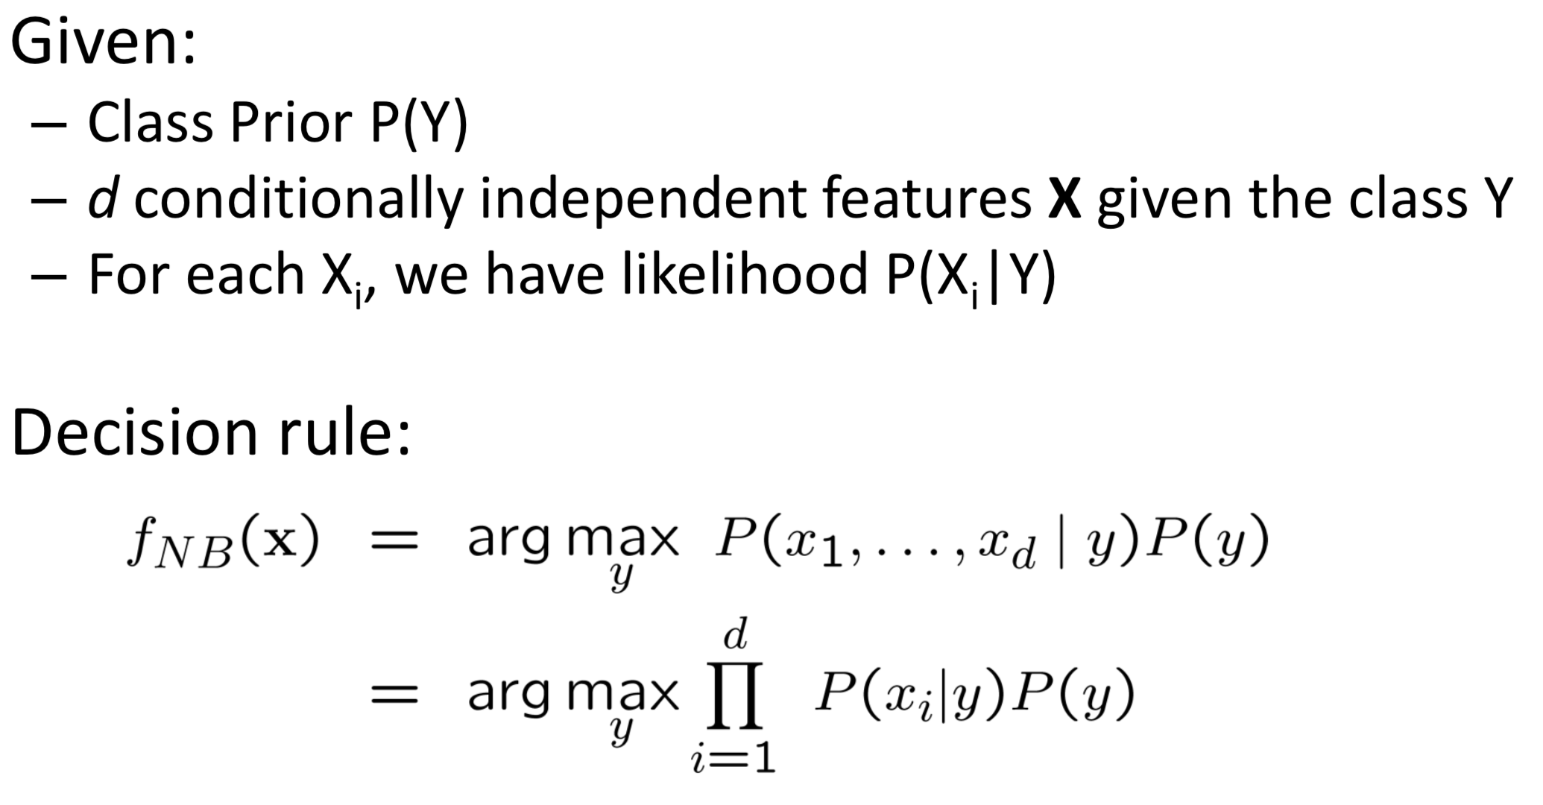
Naïve Bayes Classifier

Slide 14
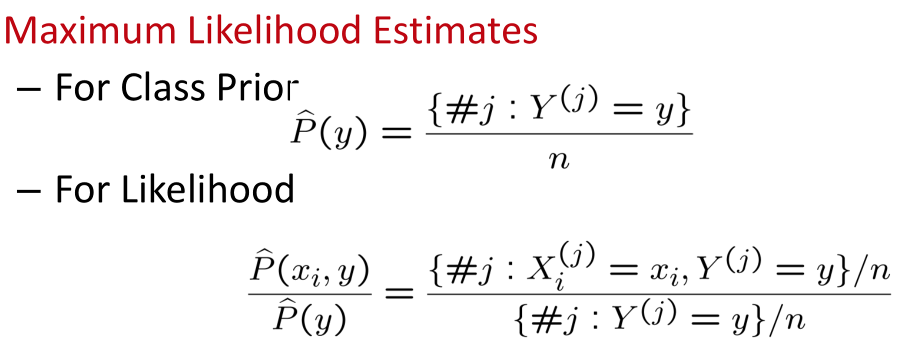
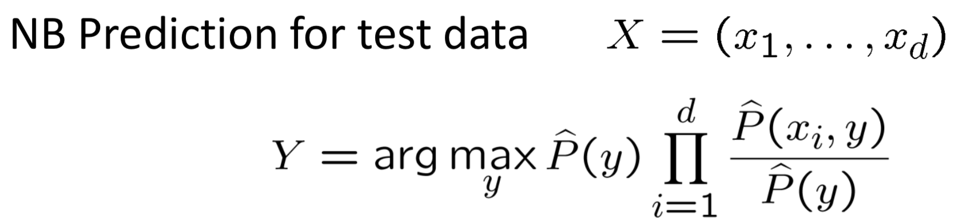
Naïve Bayes Algorithm

Slide 15
So, In our case…

Slide 16

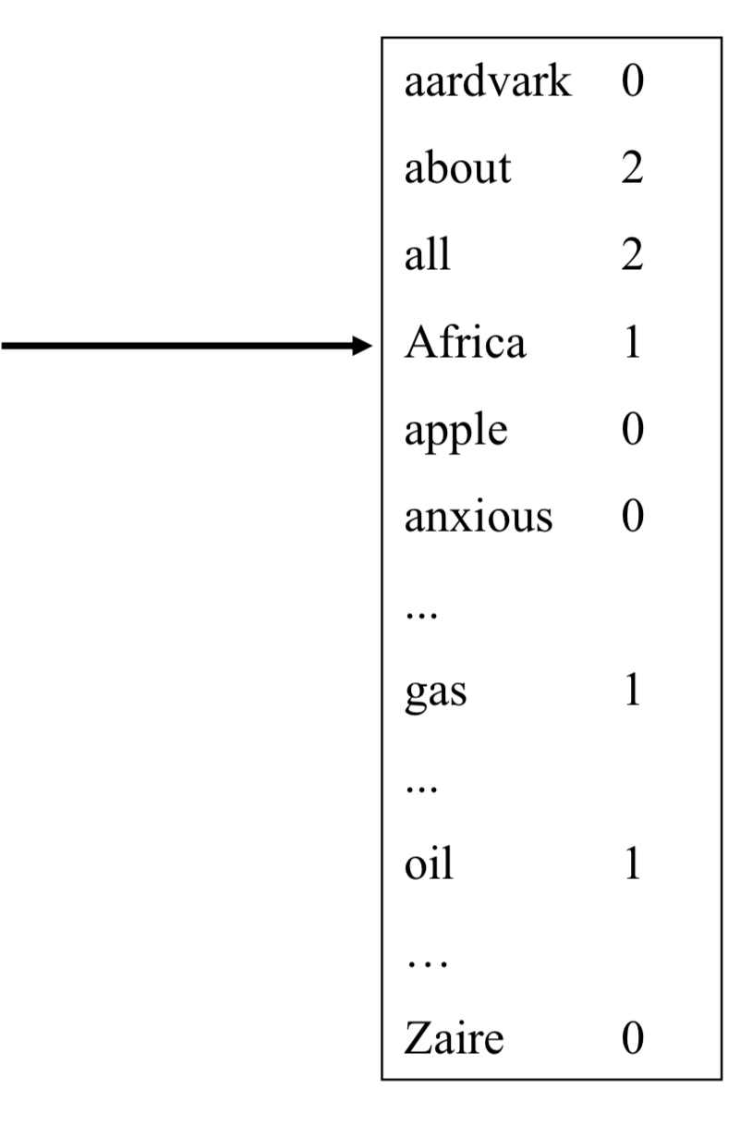
Bag of Words model

Slide 17
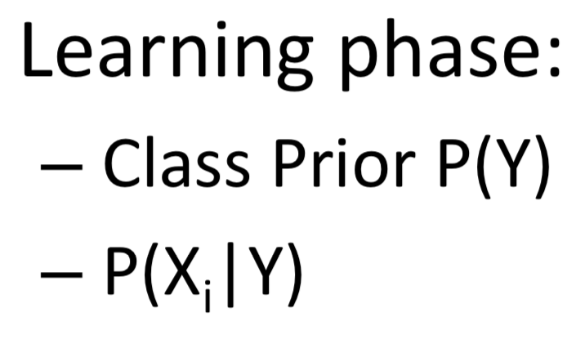
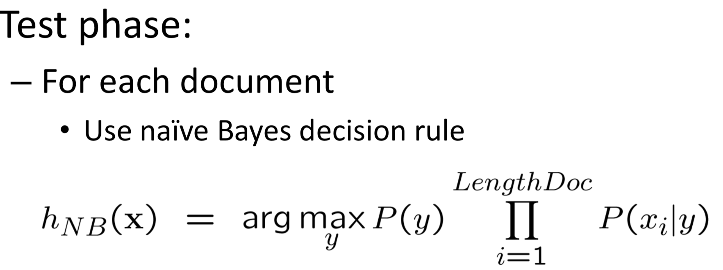
Naïve Bayes for documents

Slide 18
ScaLing To Large Vocabularies: WHY

Slide 19
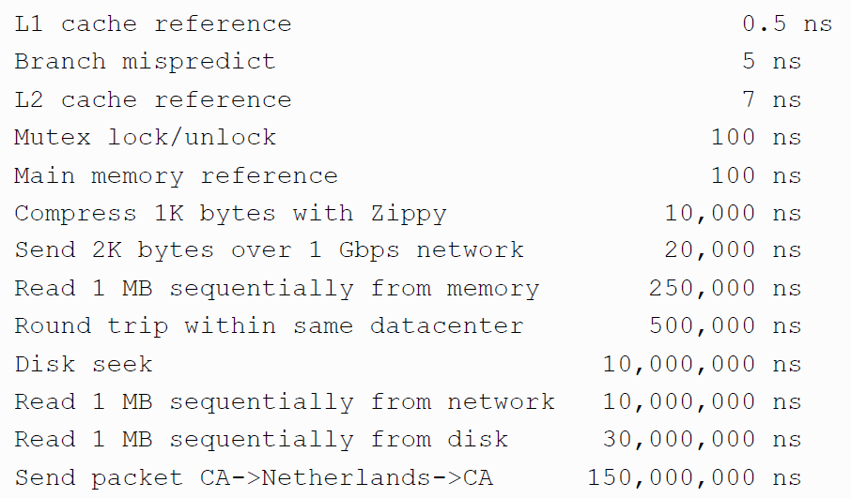
Numbers (Jeff Dean says) Everyone Should Know
~= 10x
~= 15x
40x
~= 100,000x
Notes:
150x – commercial flight vs a brisk walk
100,000x – 5 hr flights would take 57 years
100,000x – 500 miles vs about 8 meters
15,000,000x – here to beijing vs 100 meters

Slide 20

Large Vocabularies
How to implement Naïve Bayes
Assuming the event counters do not fit in memory
Possible approaches:
Use a database? (or at least a key-value store)

Slide 21
Complexity of Naïve Bayes
You have a train dataset and a test dataset
Initialize an “event counter” (hashtable) C
For each example id, y, x₁,….,x_{d} in train:
C(“Y=ANY”) ++; C(“Y=y”) ++
For j in 1..d:
C(“Y=y ^ X=x_{j}”) ++
C(“Y=y ^ X=ANY”) ++
For each example id, y, x₁,….,x_{d} in test:
For each y’ in dom(Y):
Compute log Pr(y’,x₁,….,x_{d}) =
Return the best y’
where:
q_{x} = 1/|V|
q_{y} = 1/|dom(Y)|
m=1

Slide 22
And now for something completely different

Slide 23
P0 Review
How was it?

Slide 24
P0 Review: Good Version Control Habits
DON’T
DO
Hard-code program arguments (read the instructions)
Include data or program output in version control
Use Jupyter notebooks for program code
Leave commit comments of “p0 update”
Start at the last minute
Use tickets (Issues)
Leave descriptive commit messages (“Fixed bug from ticket #3”)
Create CONTRIBUTORS, LICENSE, and README files
Create a logical directory structure (“src”, “examples”, etc)
Use Jupyter notebooks and toy data sets as examples for new users

Slide 25
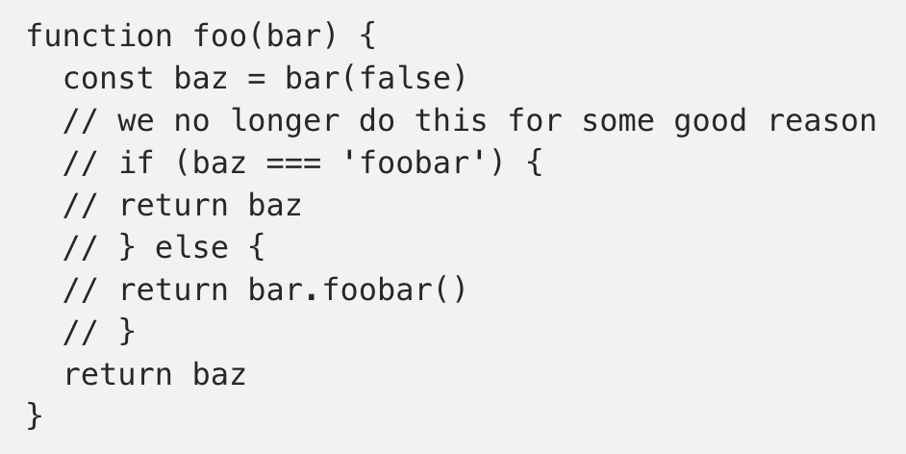
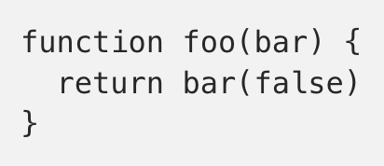

https://blog.kentcdodds.com/please-don-t-commit-commented-out-code-53d0b5b26d5f

Slide 26
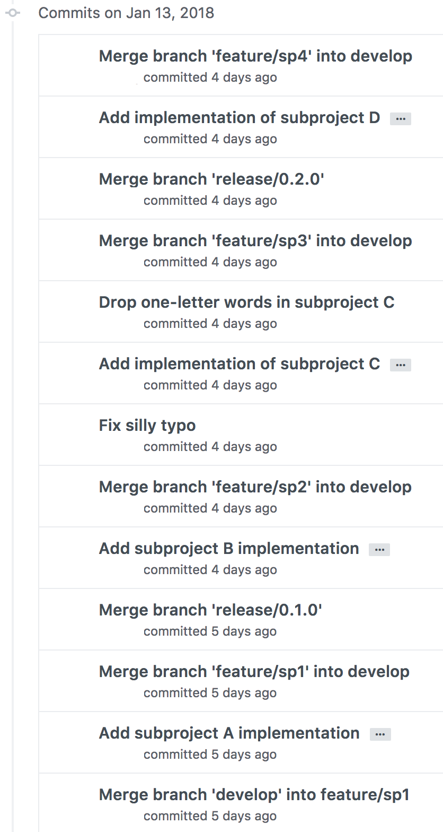
P0 Review: Commit Messages
Actual commit messages from a student
…that’s just 1 day’s worth

Slide 27
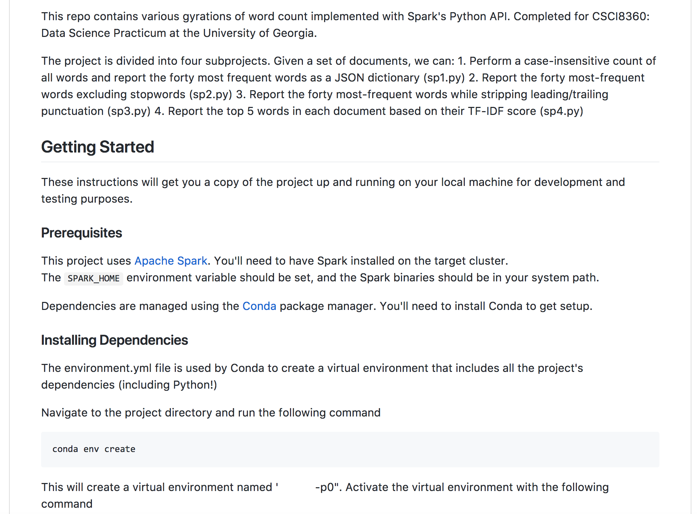
P0 Review: README
Again, an example from a student

Slide 28
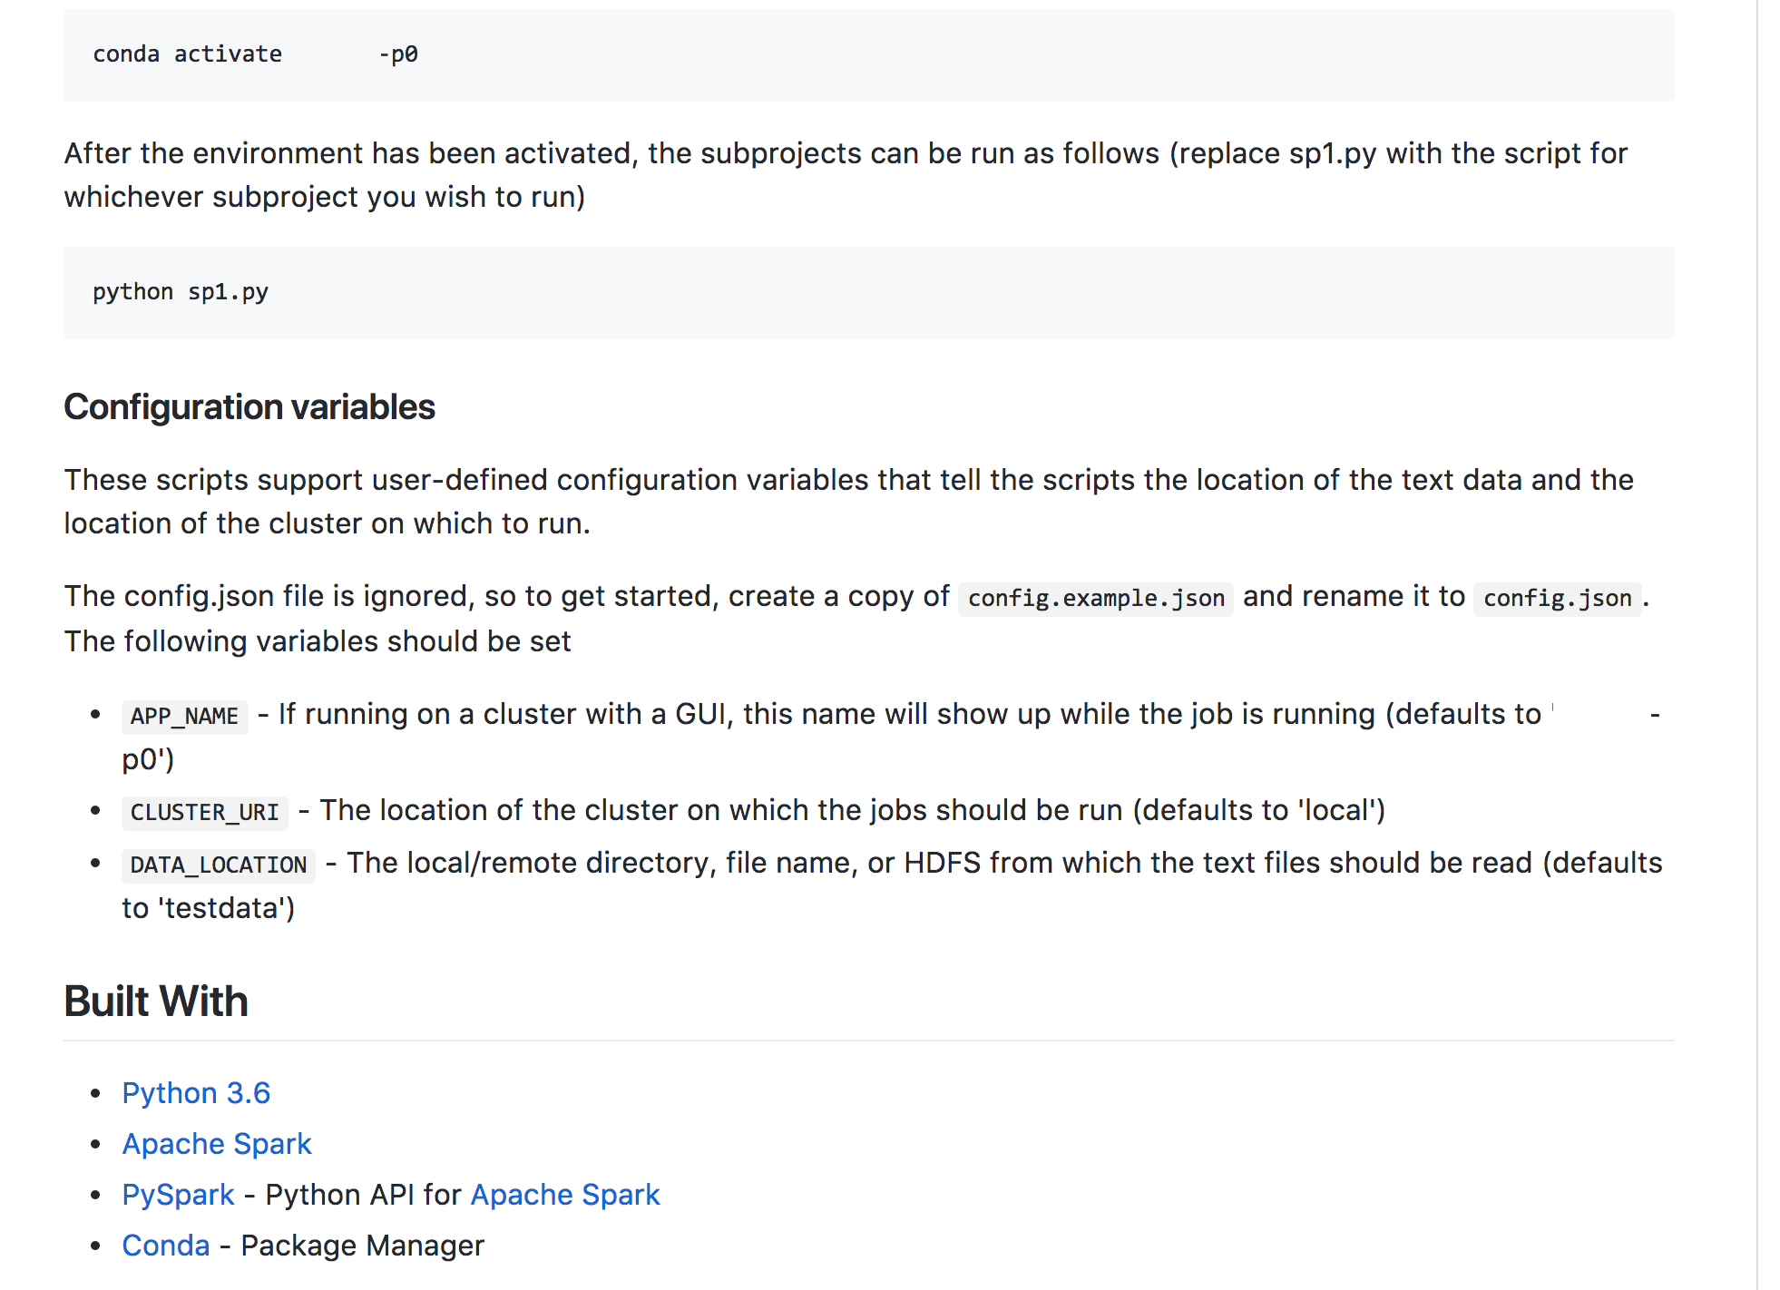

Slide 29
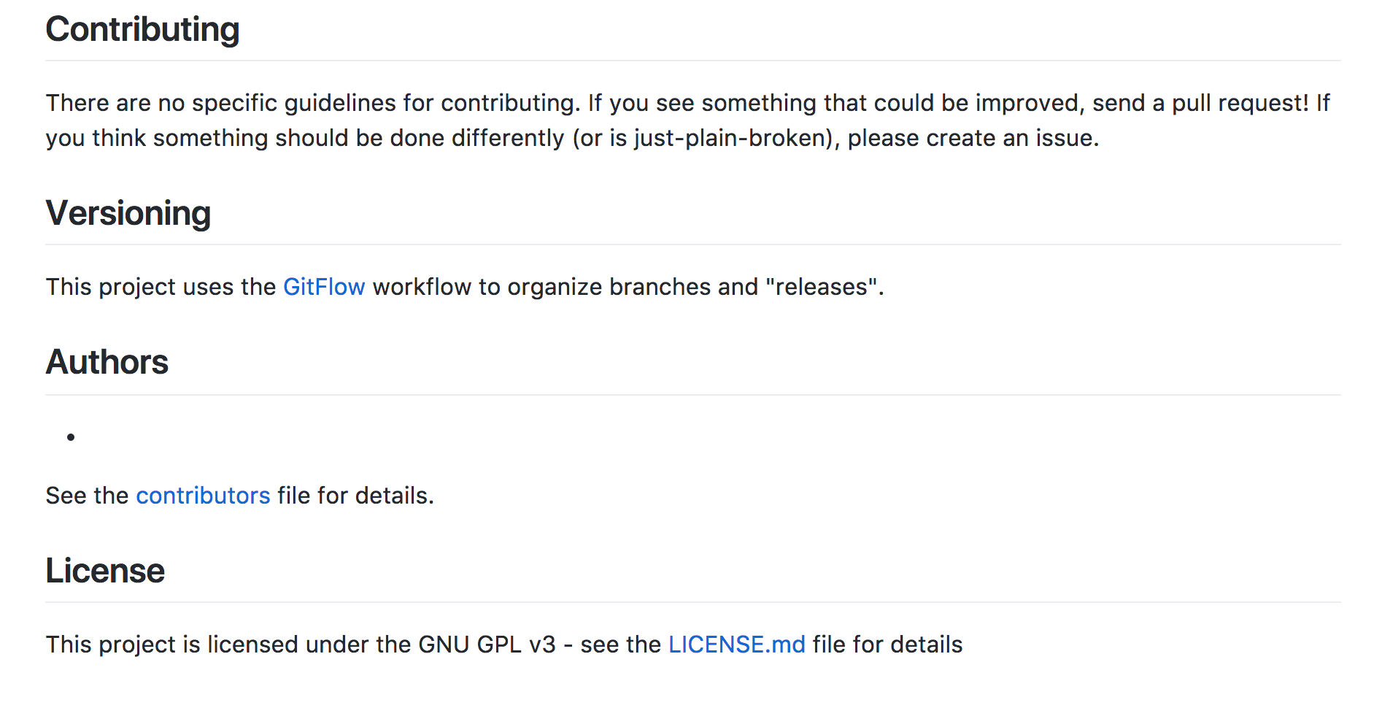

Slide 30
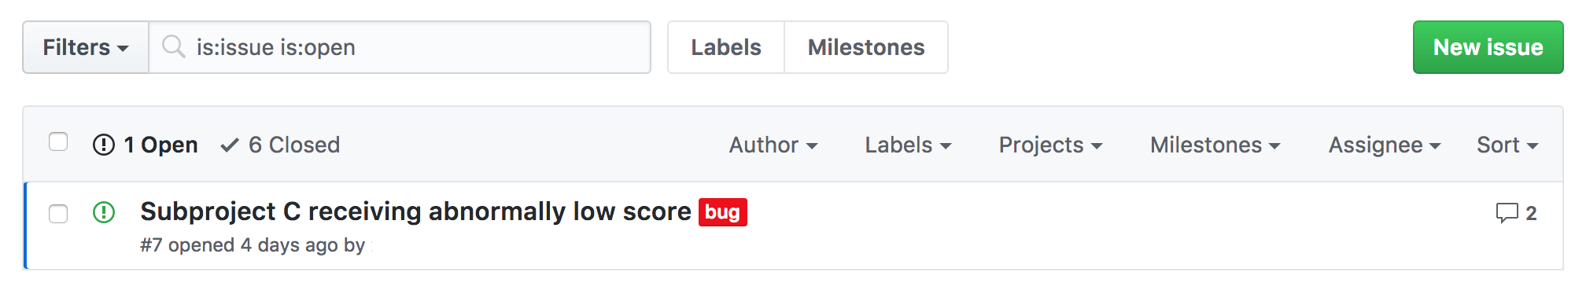
P0 Review: Tickets

Slide 31
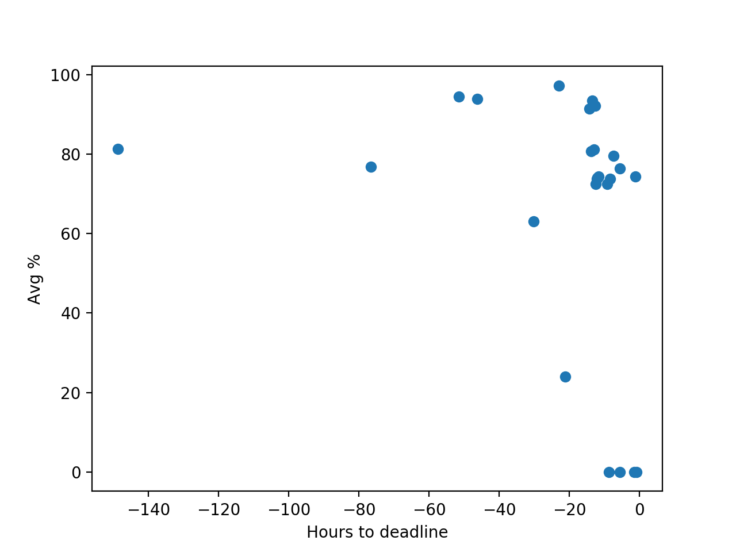
P0 Review
Average score on AutoLab as a function of hours-to-deadline
Yes, R² isn’t great
But seriously: submit early, submit often

Slide 32
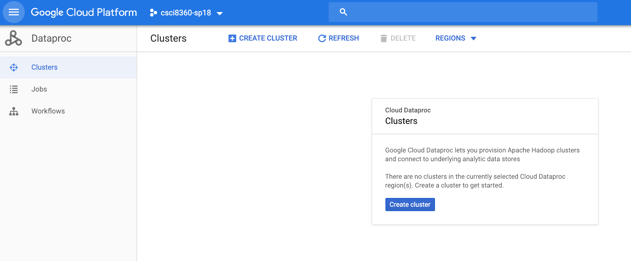
Google Cloud Platform
https://console.cloud.google.com/
Dataproc (for Spark clusters)
Bootstrap scripts
https://github.com/dsp-uga/sp19/tree/master/scripts

Slide 33
P1
Treat a single malware instance as a document
Consider hexadecimal bytes as words (they’re literally called that, anyway)
Basic: Compute TF-IDF and feed into Naïve Bayes classifier (+ smoothing)
Moderate: Build bigram TF-IDF feature sets and feed into Naïve Bayes / Logistic Regression
Advanced: Consider byte files as images and use image processing to classify malware

